Slide 1

Contour Launchpad - Summer Internship Program 2025
SMARTGRADE
Subjective Answer Evaluation System
Presented By: Qurat-ul-Ain Akhter
Employee ID: 132347
01

Slide 2






The Problem – Why Manual Checking and Grading Is Broken
🎓 The Education Paradox
Subjective Evaluation Is
Student Efforts
Evaluation Reality
Time Consuming
Inconsistent
Biased
Opaque
02

Slide 3

📊 Real Impact:
01
15–30% score variation in manual grading due to human error (SCITEPRESS, Abhay et al., 2023)
03
Teacher overload: One teacher grades 250+ papers in under-resourced schools without rubrics (IRJMETS, Shaikh et al., 2024)
02
Lack of detailed feedback limits student improvement and learning outcomes (ScienceDirect, Li et al., 2023)
04
Unfair or delayed grading leads to poor motivation and higher dropout rates in online education (IRJMETS, 2024)
03

Slide 4

Proposed Solution
SMARTGRADE
SMARTGRADE is an AI-powered system designed to automate the evaluation of subjective answers. It addresses the limitations of manual grading by ensuring fairness, accuracy, and scalability. The system supports both typed and handwritten responses, provides detailed feedback, and detects plagiarism to maintain academic integrity. By combining deep semantic understanding with intelligent automation, SMARTGRADE transforms the grading process for modern education.
04

Slide 5


Market Trends
Growing adoption of AI in education, especially in assessment and evaluation.
Increased need for automation post-COVID in remote and hybrid learning environments.
Rising demand for objective, fast, and scalable evaluation systems.
Market Demand:
High demand for automated subjective grading due to large-scale assessments.
Institutions seeking solutions that reduce workload and improve grading fairness.
The global EdTech market is projected to reach approximately $348 billion by 2030, driven by increasing demand for digital learning solutions and automation in education (Grand View Research, 2024).
05

Slide 6


STAKEHOLDERS MAPING
Primary: Schools, colleges, universities.
Secondary: Exam boards, EdTech platforms, certification bodies.
End Users: Teachers, students, evaluators, academic administrators.
Target Market:
Higher education institutions conducting written assessments.
Online learning platforms offering subjective question modules.
Examination boards and testing agencies.
Educators seeking efficient, unbiased grading tools.
06

Slide 7

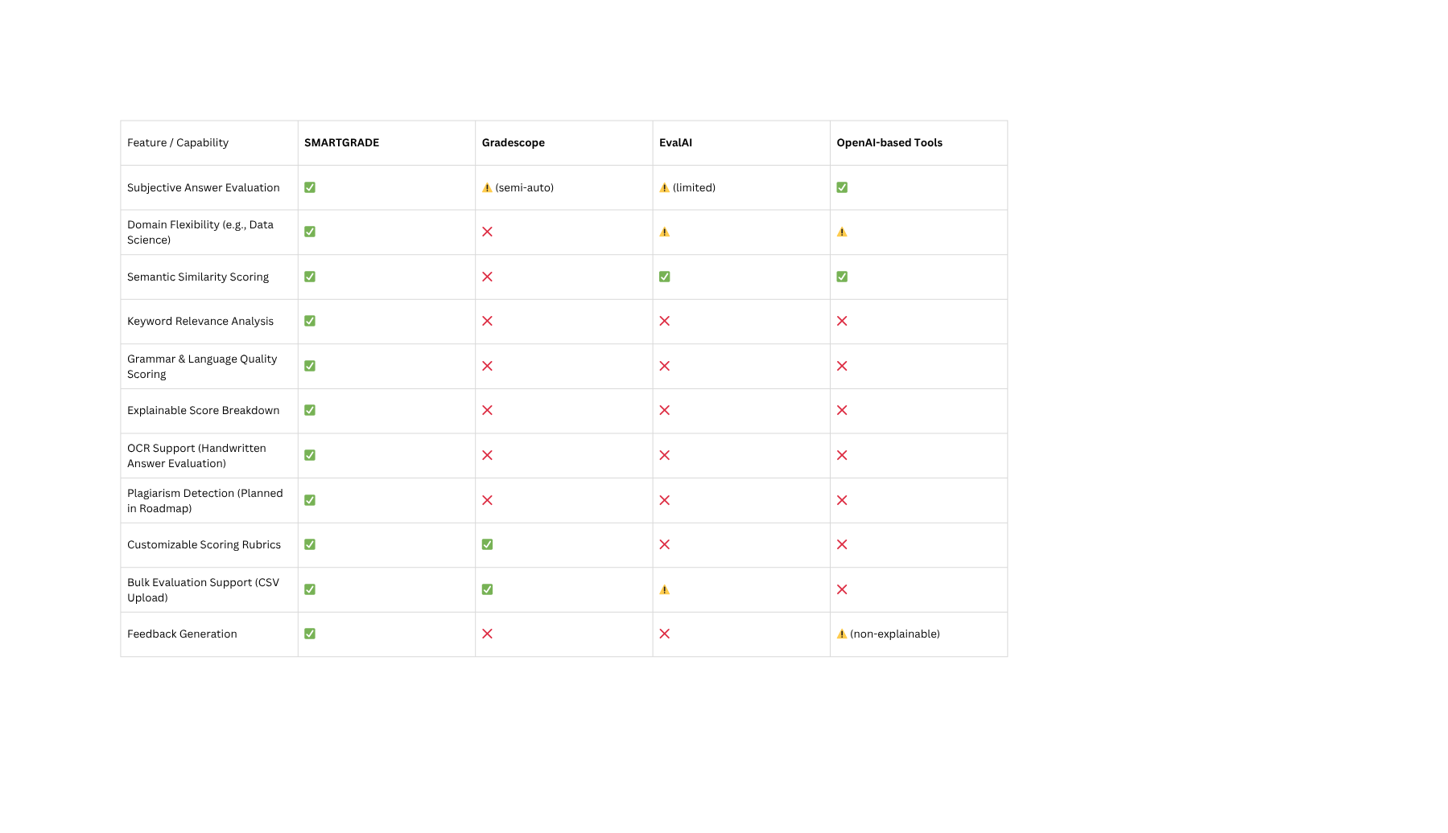
COMPETITIVE ANALYSIS
07

Slide 8
Automated Answer Evaluation
Dual Scoring Mechanism
Scalability & Speed
Feedback Generation
SMARTGRADE
Fair and Unbiased Evaluation
Plagiarism Detection
08

Slide 9
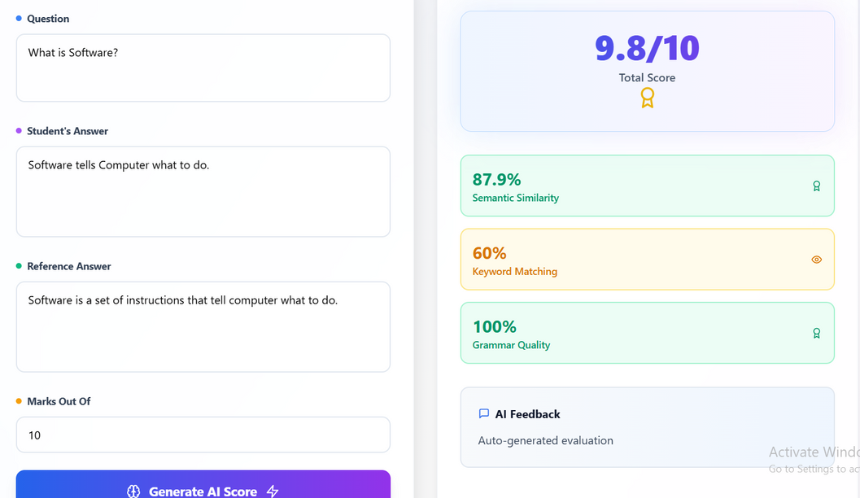
Single Answer Evaluation
09

Slide 10
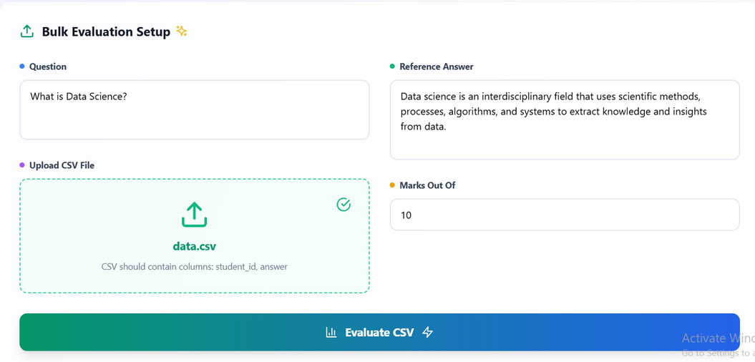
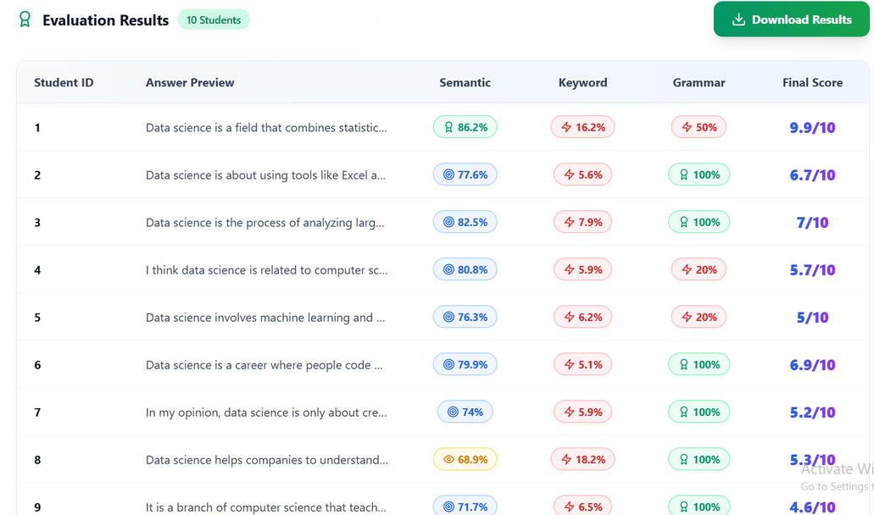
Bulk Answer Evaluation
10

Slide 11
TECHNICAL ARCHITECTURE
Phases:
Data Preparation
Model Development
Frontend & Backend Integration
🧮 Scoring Approaches
Rule-Based (Weighted Aggregation):
Semantic: 70%
Keyword: 25%
Grammar: 5%
Machine Learning Models:
Trained on three features (semantic, keyword, grammar)
Models: Linear Regression, SVR, Random Forest, XGBoost
Best Performer: Gradient Boosting
🧠 Backend – Python + Flask
Semantic Similarity:
Transformer model: all-MiniLM-L6-v2
Cosine similarity for vector comparison
Keyword Relevance:
Jaccard similarity after NLP preprocessing
Grammar Quality:
spaCy parser to detect syntactic errors
Normalized to a score between 0 and 1
💻 Frontend – React.js
Single Answer Check: Manual input + score breakdown
Bulk Evaluation: CSV upload + downloadable results
11

Slide 12

CHALLANGES AND LIMITATIONS
⚠️ Data limitations
Real student answers unavailable → AI-generated
Time-consuming data simulation
⚠️ Model limitations
Generic transformers → limited domain specificity
Need for better accuracy in real-world scenarios
12

Slide 13


Future Plans
1 Year
3 Years
1 Year
Improve model accuracy using real-world student response data.
Conduct pilots to validate performance in diverse academic settings.
Integrate AI-based personalized feedback generation.
Expand subject coverage and language support.
Enhance usability for educators and students.
Implement advanced plagiarism detection across typed and handwritten answers.
Position SMARTGRADE for large-scale adoption in national assessments.
13

Slide 14
THANK YOU
QUESTIONS??
14

